Slide 1
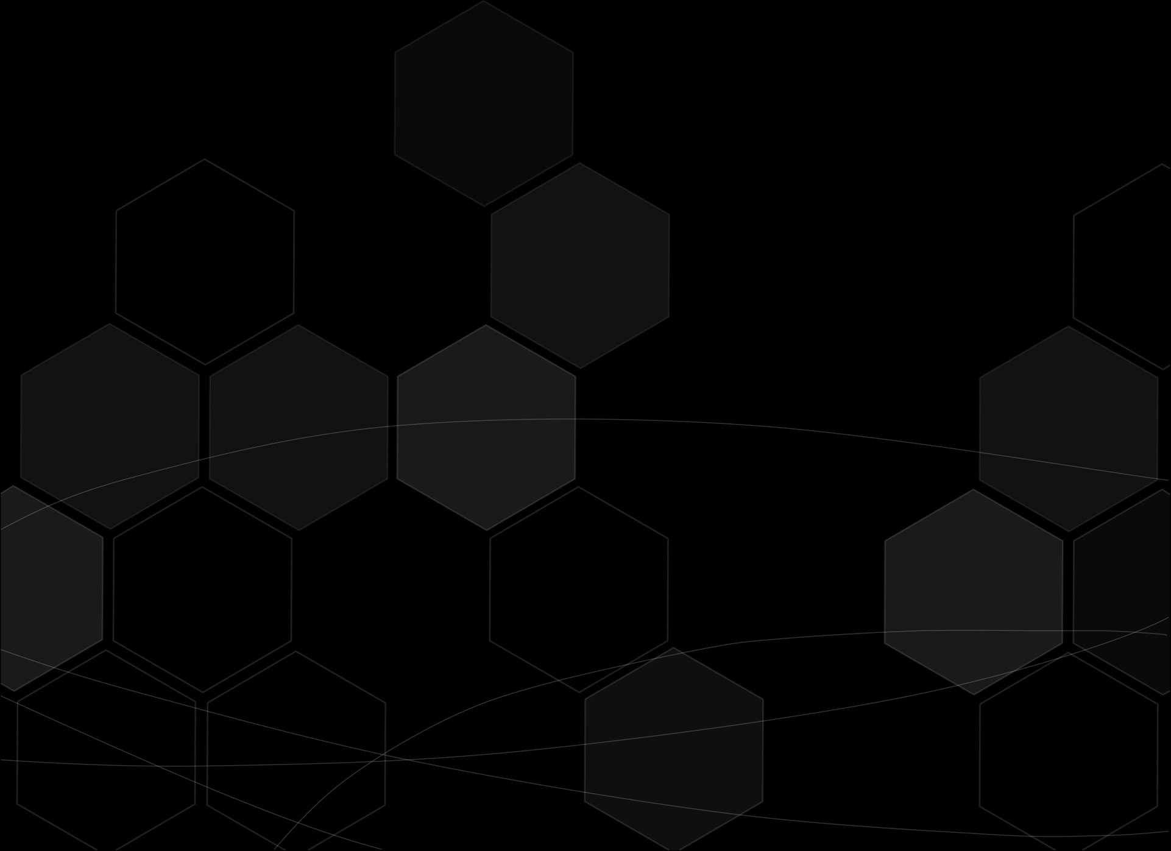
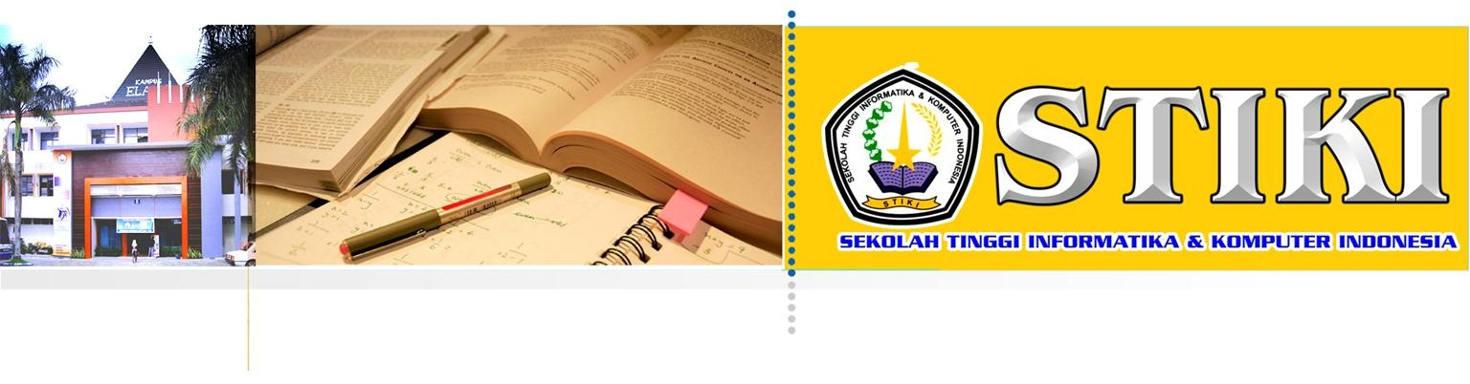
Data Structures and Algorithm II
Emerging of Data Structures and Algorithm
Addin Aditya, S.Kom., M.Kom.
addin@stiki.ac.id

Slide 2
Overview
Data Structures are the programmatic way of storing data so that data can be used efficiently.
Almost every enterprise application uses various types of data structures in one or the other way

Slide 3
Following terms are the foundation terms of a data structure
Interface − Each data structure has an interface. Interface represents the set of operations that a data structure supports. An interface only provides the list of supported operations, type of parameters they can accept and return type of these operations.
Implementation − Implementation provides the internal representation of a data structure. Implementation also provides the definition of the algorithms used in the operations of the data structure

Slide 4
Characteristic of Data Structure
Correctness − Data structure implementation should implement its interface correctly.
Time Complexity − Running time or the execution time of operations of data structure must be as small as possible.
Space Complexity − Memory usage of a data structure operation should be as little as possible

Slide 5
Needs of Data Structures
Data Search − Consider an inventory of 1 million(10⁶) items of a store. If the application is to search an item, it has to search an item in 1 million(10⁶) items every time slowing down the search. As data grows, search will become slower.
Processor speed − Processor speed although being very high, falls limited if the data grows to billion records.
Multiple requests − As thousands of users can search data simultaneously on a web server, even the fast server fails while searching the data

Slide 6
Execution Time Cases
Worst Case − This is the scenario where a particular data structure operation takes maximum time it can take. If an operation's worst case time is ƒ(n) then this operation will not take more than ƒ(n) time where ƒ(n) represents function of n.
Average Case − This is the scenario depicting the average execution time of an operation of a data structure. If an operation takes ƒ(n) time in execution, then m operations will take mƒ(n) time.
Best Case − This is the scenario depicting the least possible execution time of an operation of a data structure. If an operation takes ƒ(n) time in execution, then the actual operation may take time as the random number which would be maximum as ƒ(n)

Slide 7
Basic Terminology
Data − Data are values or set of values.
Data Item − Data item refers to single unit of values.
Group Items − Data items that are divided into sub items are called as Group Items.
Elementary Items − Data items that cannot be divided are called as Elementary Items.
Attribute and Entity − An entity is that which contains certain attributes or properties, which may be assigned values
Entity Set − Entities of similar attributes form an entity set.
Field − Field is a single elementary unit of information representing an attribute of an entity.
Record − Record is a collection of field values of a given entity.
File − File is a collection of records of the entities in a given entity set

Slide 8
Algorithm Basics
From the data structure point of view, following are some important categories of algorithms
Search − Algorithm to search an item in a data structure.
Sort − Algorithm to sort items in a certain order.
Insert − Algorithm to insert item in a data structure.
Update − Algorithm to update an existing item in a data structure.
Delete − Algorithm to delete an existing item from a data structure

Slide 9
Characteristics of an Algorithm
Unambiguous − Algorithm should be clear and unambiguous. Each of its steps (or phases), and their inputs/outputs should be clear and must lead to only one meaning.
Input − An algorithm should have 0 or more well-defined inputs.
Output − An algorithm should have 1 or more well-defined outputs, and should match the desired output.
Finiteness − Algorithms must terminate after a finite number of steps.
Feasibility − Should be feasible with the available resources.
Independent − An algorithm should have step-by-step directions, which should be independent of any programming code

Slide 10
How to Write an Algorithm?
There are no well-defined standards for writing algorithms. Rather, it is problem and resource dependent. Algorithms are never written to support a particular programming code.
As we know that all programming languages share basic code constructs like loops (do, for, while), flow-control (if-else), etc. These common constructs can be used to write an algorithm.
We write algorithms in a step-by-step manner, but it is not always the case. Algorithm writing is a process and is executed after the problem domain is well-defined. That is, we should know the problem domain, for which we are designing a solution

Slide 11
Examples..
Please design an algorithm to add two numbers and display the result:
Step 1 − START
Step 2 − declare three integers a, b & c
Step 3 − define values of a & b
Step 4 − add values of a & b
Step 5 − store output of step 4 to c
Step 6 − print c
Step 7 − STOP

Slide 12
Examples..
Algorithms tell the programmers how to code the program. Alternatively, the algorithm can be written as
Step 1 − START ADD
Step 2 − get values of a & b
Step 3 − c ← a + b
Step 4 − display c
Step 5 − STOP

Slide 13
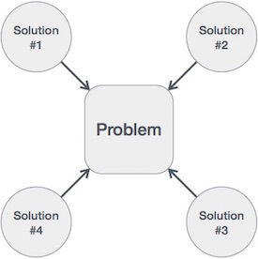
Examples
We design an algorithm to get a solution of a given problem. A problem can be solved in more than one ways

Slide 14
Algorithm Analysis
A Priori Analysis − This is a theoretical analysis of an algorithm. Efficiency of an algorithm is measured by assuming that all other factors, for example, processor speed, are constant and have no effect on the implementation.
A Posterior Analysis − This is an empirical analysis of an algorithm. The selected algorithm is implemented using programming language. This is then executed on target computer machine. In this analysis, actual statistics like running time and space required, are collected

Slide 15
Algorithm Complexity
Suppose X is an algorithm and n is the size of input data, the time and space used by the algorithm X are the two main factors, which decide the efficiency of X
Time Factor − Time is measured by counting the number of key operations such as comparisons in the sorting algorithm.
Space Factor − Space is measured by counting the maximum memory space required by the algorithm
The complexity of an algorithm f(n) gives the running time and/or the storage space required by the algorithm in terms of n as the size of input data

Slide 16
Space Complexity
Space complexity of an algorithm represents the amount of memory space required by the algorithm in its life cycle. The space required by an algorithm is equal to the sum of the following two components
A fixed part that is a space required to store certain data and variables, that are independent of the size of the problem. For example, simple variables and constants used, program size, etc.
A variable part is a space required by variables, whose size depends on the size of the problem. For example, dynamic memory allocation, recursion stack space, etc

Slide 17
Time Complexity
Time complexity of an algorithm represents the amount of time required by the algorithm to run to completion. Time requirements can be defined as a numerical function T(n), where T(n) can be measured as the number of steps, provided each step consumes constant time.
For example, addition of two n-bit integers takes n steps. Consequently, the total computational time is T(n) = c ∗ n, where c is the time taken for the addition of two bits. Here, we observe that T(n) grows linearly as the input size increases

Slide 18
Algoritma Greedy

Slide 19
Pendahuluan
Algoritma greedy merupakan metode yang paling populer untuk memecahkan persoalan optimasi.
Persoalan optimasi (optimization problems):
➔ persoalan mencari solusi optimum.
Hanya ada dua macam persoalan optimasi:
1. Maksimasi (maximization)
2. Minimasi (minimization)

Slide 20
Contoh persoalan optimasi:
( Masalah Penukaran Uang): Diberikan uang senilai A. Tukar A dengan koin-koin uang yang ada. Berapa jumlah minimum koin yang diperlukan untuk penukaran tersebut?
➔ Persoalan minimasi

Slide 21
Contoh 1: tersedia banyak koin 1, 5, 10, 25
Uang senilai A = 32 dapat ditukar dengan banyak cara berikut:
32 = 1 + 1 + … + 1 (32 koin)
32 = 5 + 5 + 5 + 5 + 10 + 1 + 1 (7 koin)
32 = 10 + 10 + 10 + 1 + 1 (5 koin)
… dst
Minimum: 32 = 25 + 5 + 1 + 1 (4 koin)

Slide 22
Greedy = rakus, tamak, loba, …
Prinsip greedy: “take what you can get now!”.
Algoritma greedy membentuk solusi langkah per langkah (step by step).
Pada setiap langkah, terdapat banyak pilihan yang perlu dieksplorasi.
Oleh karena itu, pada setiap langkah harus dibuat keputusan yang terbaik dalam menentukan pilihan.

Slide 23
Pada setiap langkah, kita membuat pilihan optimum lokal (local optimum)
dengan harapan bahwa langkah sisanya mengarah ke solusi optimum global (global optimm).

Slide 24
Elemen-elemen algoritma greedy:
1. Himpunan kandidat, C.
2. Himpunan solusi, S
3. Fungsi seleksi (selection function)
4. Fungsi kelayakan (feasible)
5. Fungsi obyektif
Dengan kata lain:
algoritma greedy melibatkan pencarian sebuah himpunan bagian, S, dari himpunan kandidat, C;
yang dalam hal ini, S harus memenuhi beberapa kriteria yang ditentukan, yaitu menyatakan suatu solusi dan S dioptimisasi oleh fungsi obyektif.

Slide 25
Pada masalah penukaran uang:
Himpunan kandidat: himpunan koin yang merepresentasikan nilai 1, 5, 10, 25, paling sedikit mengandung satu koin untuk setiap nilai.
Himpunan solusi: total nilai koin yang dipilih tepat sama jumlahnya dengan nilai uang yang ditukarkan.
Fungsi seleksi: pilihlah koin yang bernilai tertinggi dari himpunan kandidat yang tersisa.
Fungsi layak: memeriksa apakah nilai total dari himpunan koin yang dipilih tidak melebihi jumlah uang yang harus dibayar.
Fungsi obyektif: jumlah koin yang digunakan minimum.

Slide 26
Skema algoritma greedy:
Pada akhir setiap lelaran, solusi yang terbentuk adalah optimum lokal.
Pada akhir kalang while-do diperoleh optimum global.

Slide 27
Warning: Optimum global belum tentu merupakan solusi optimum (terbaik), tetapi sub-optimum atau pseudo-optimum.
Alasan:
1. Algoritma greedy tidak beroperasi secara menyeluruh
terhadap semua alternatif solusi yang ada
(sebagaimana pada metode exhaustive search).
2. Terdapat beberapa fungsi SELEKSI yang berbeda,
sehingga kita harus memilih fungsi yang tepat jika kita
ingin algoritma menghasilkan solusi optiamal.
Jadi, pada sebagian masalah algoritma greedy tidak selalu berhasil memberikan solusi yang optimal.

Slide 28
Contoh 2: tinjau masalah penukaran uang.
(a) Koin: 5, 4, 3, dan 1
Uang yang ditukar = 7.
Solusi greedy: 7 = 5 + 1 + 1 ( 3 koin) → tidak optimal
Solusi optimal: 7 = 4 + 3 ( 2 koin)
(b) Koin: 10, 7, 1
Uang yang ditukar: 15
Solusi greedy: 15 = 10 + 1 + 1 + 1 + 1 + 1 (6 koin)
Solusi optimal: 15 = 7 + 7 + 1 (hanya 3 koin)
(c) Koin: 15, 10, dan 1
Uang yang ditukar: 20
Solusi greedy: 20 = 15 + 1 + 1 + 1 + 1 + 1 (6 koin)
Solusi optimal: 20 = 10 + 10 (2 koin)

Slide 29
Untuk sistem mata uang dollar AS, euro Eropa, dan crown Swedia, algoritma greedy selalu memberikan solusi optimum.
Contoh: Uang $6,39 ditukar dengan uang kertas (bill) dan koin sen (cent), kita dapat memilih:
- Satu buah uang kertas senilai $5
- Satu buah uang kertas senilai $1
- Satu koin 25 sen
- Satu koin 10 sen
- Empat koin 1 sen
$5 + $1 + 25c + 10c + 1c + 1c + 1c + 1c = $6,39

Slide 30
Jika jawaban terbaik mutlak tidak diperlukan, maka algoritma greedy sering berguna untuk menghasilkan solusi hampiran (approximation), daripada menggunakan algoritma yang lebih rumit untuk menghasilkan solusi yang eksak.
Bila algoritma greedy optimum, maka keoptimalannya itu dapat dibuktikan secara matematis

Slide 31
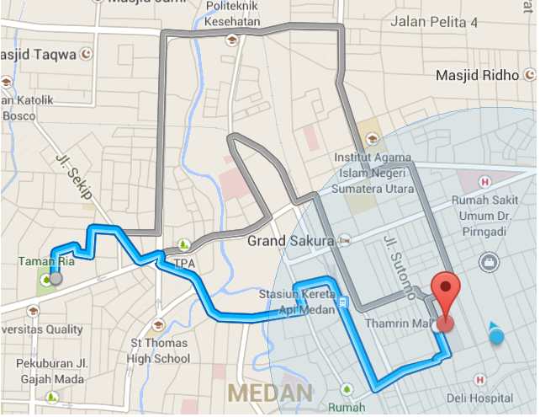
Contoh
Semisal kita ingin bergerak dari titik A ke titik B dan kita telah menemukan beberapa jalur pada peta:

Slide 32
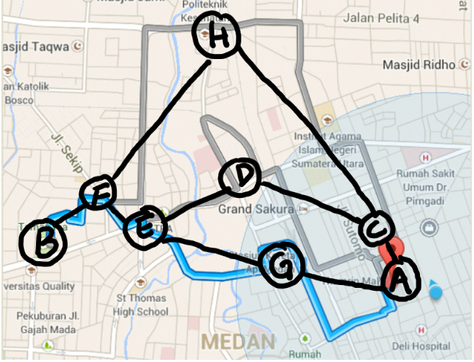

Slide 33
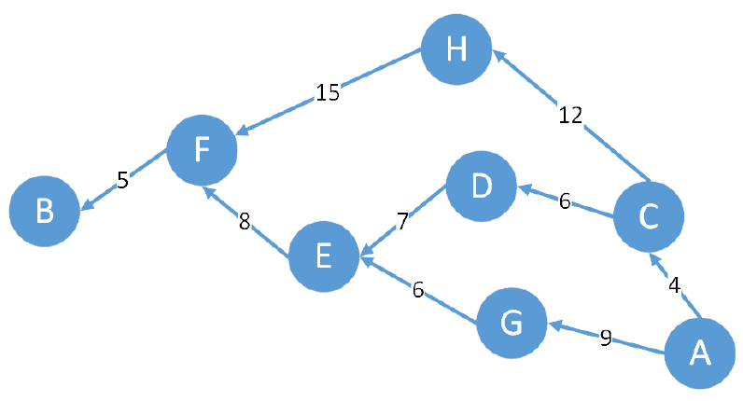

Slide 34
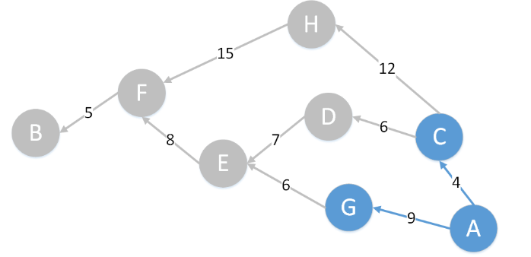

Slide 35
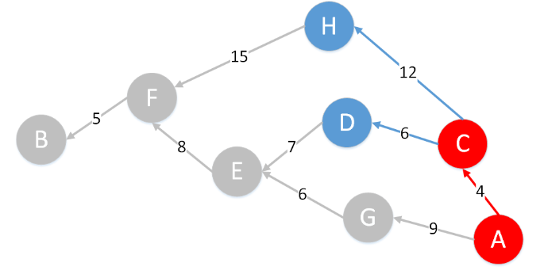

Slide 36
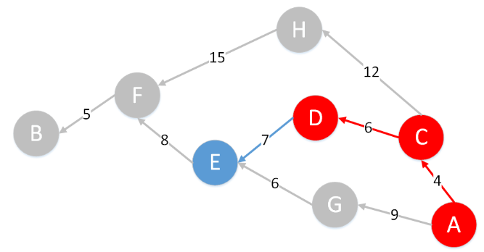

Slide 37
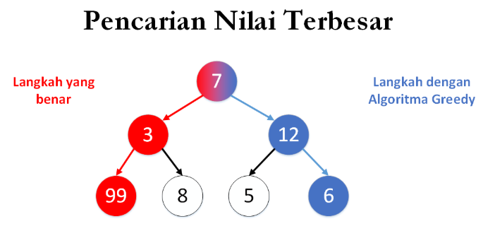

Slide 38
Thank you!
Frequently visit the eBelajar
Should you find any difficulties with eBelajar, Drop me an email right away!
addin@stiki.ac.id

